Slide 1
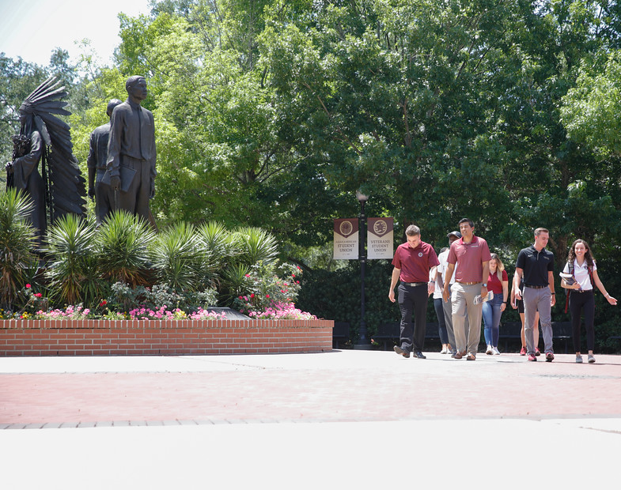
College of Education Preview Week
Fall 2022

Slide 2
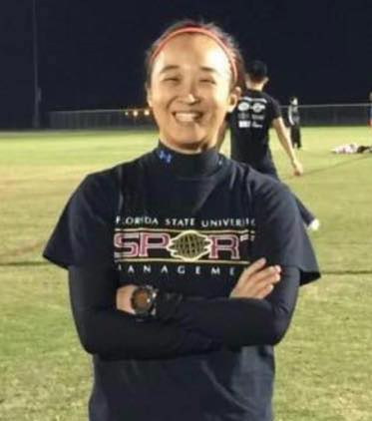
Dr. Amy Chan Hyung Kim Associate Professor Co Director, Center for SHED Management in Sport for Health
Career Highlights:
Degrees: Yonsei University (B.S.)
The Ohio State University (M.A., Ph.D.)
Work experience: Ski instructor, PE teacher, Event manager
Courses Taught: HRM in Sport, Facility & Event Management, Strategic Management, Research Methods
Areas of Interest: Effectiveness of sport participation on individual’s social and psychological/mental health; evidence-based interventions to promote sport participation and participants’ health and well-being
Sport background: Tennis, Ski, Team sports, and Racquet sports

Slide 3
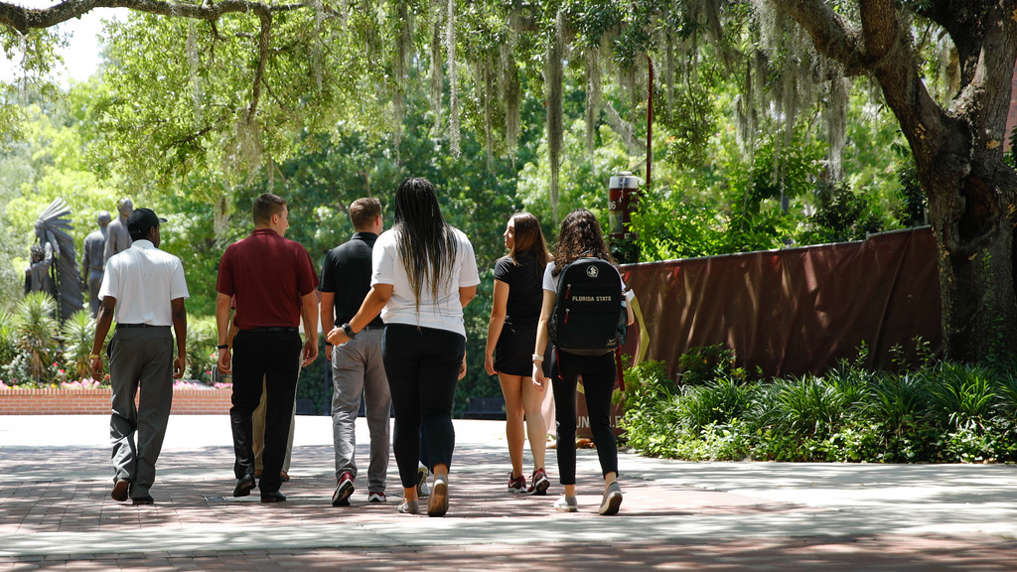
The FSU Sport Management Graduate Experience
The start of something special….
Notes:
You are about to embark on new journey…the start of something special…

Slide 4
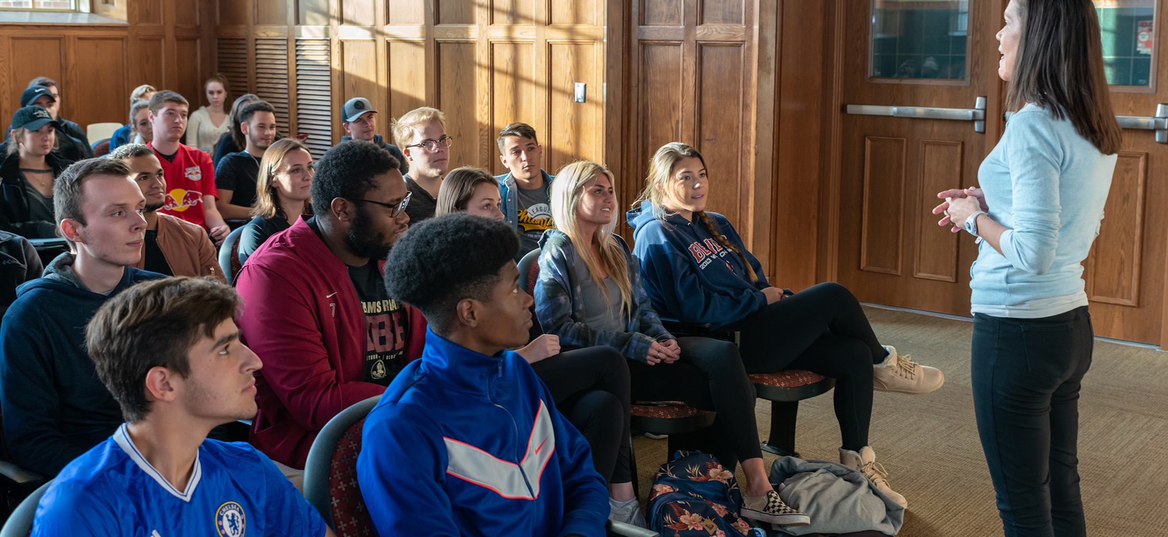
Quality Instruction
Your Sport Management faculty have been nominated for and received College and University teaching awards
You will be exposed to top-level teaching, gain new business skills, and learn from industry leaders and world-renowned scholars
Notes:
Katie – University Teaching Award
Kylee – COE Undergraduate Teaching Award Nomination
Pappas _ transformation through Teaching, Partners with a Purpose, University Teaching Award
Hanhan, Josh, Du, and others nominated for COE and University level teaching awards

Slide 5
Cutting-Edge, High-Impact Research
Our faculty among the most productive SM researchers in the world:
Published over 400 per-reviewed journal articles
Presented more than 500 papers a major conferences
Authored or edited more than 30 books
Received more than 30 federal, state, or foundation grants to support their research and programs (totaling more than $2 million)
Authored more than a dozen technical and advisory reports for government and industry agencies
Serve as Editor or on the Editorial Boards of more than 20 of our field’s leading journals
Notes:
The research of our faculty has been cited in ESPN, USA Today, Time magazine, Buzzfeed, the Atlantic, New York Times, Washington Post, etc.
Pictured: Rodenberg on 60 minutes

Slide 6
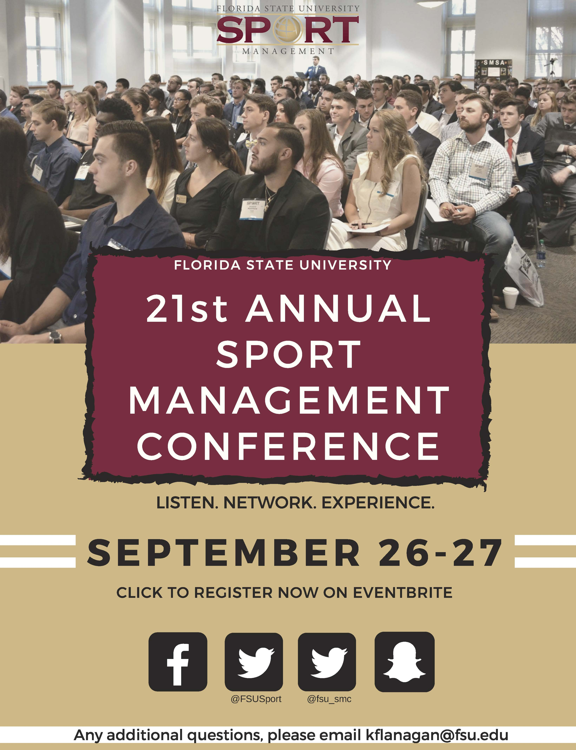
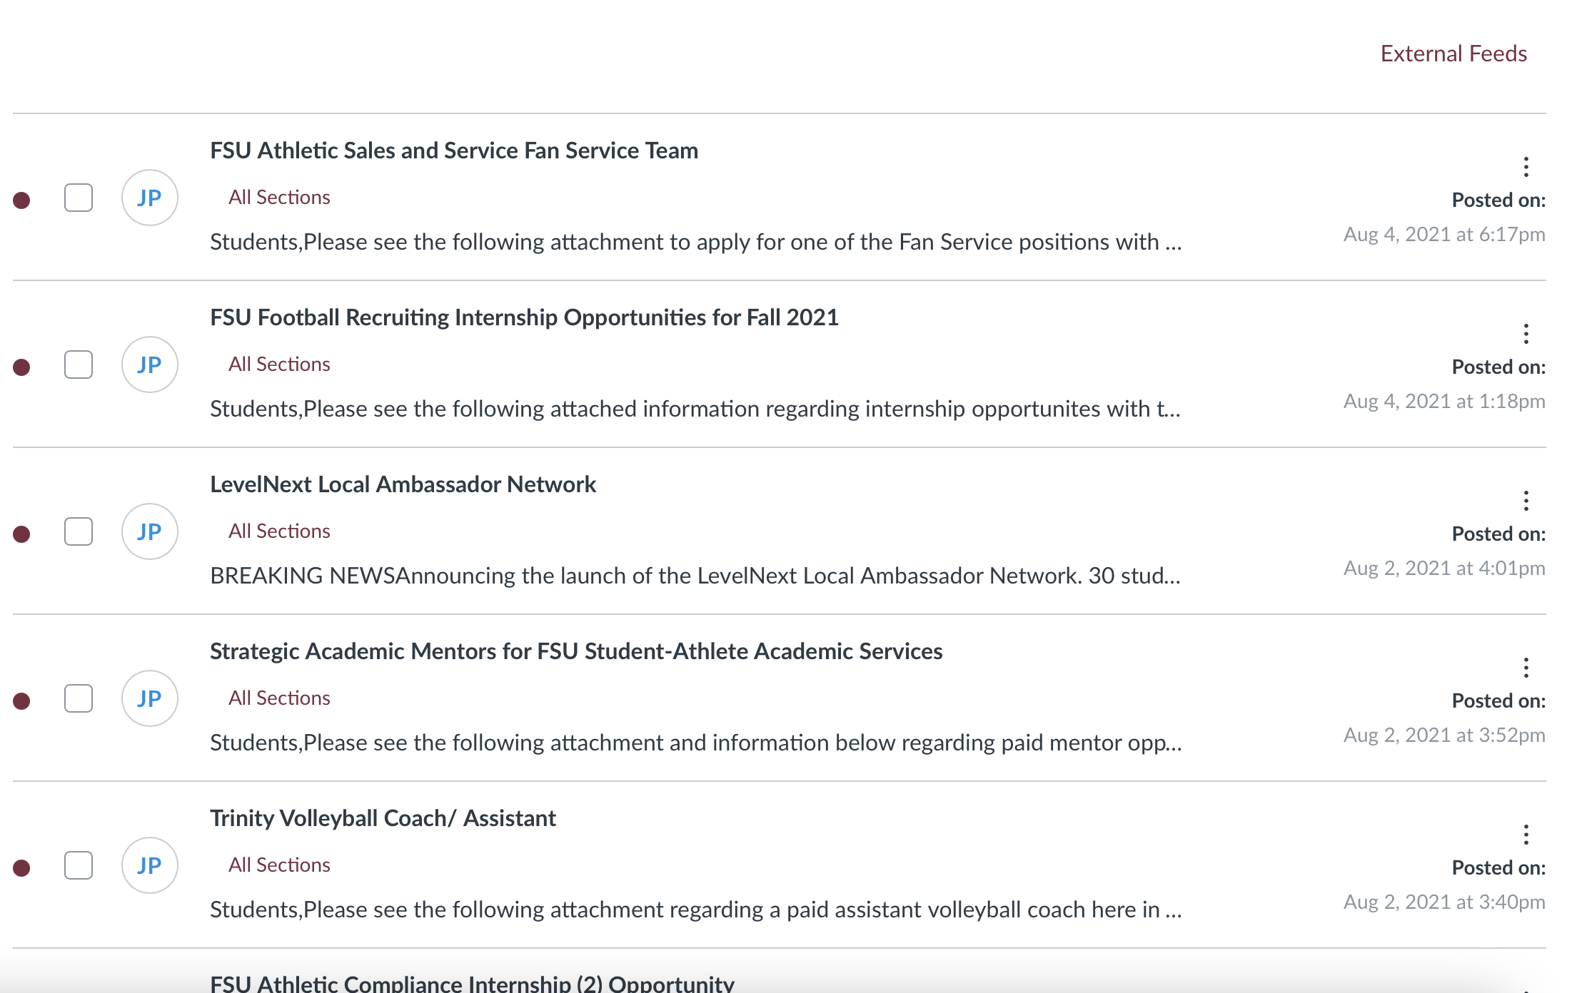
Helping You Find Your Place in the Industry
Extensive internship network
Graduate Portfolio project
Resume and Interview Prep
Sport Management Conference
Networking Fair
Networking activities
Notification of job opportunities
Notes:
Portfolio requirements (?) – require students to practice relevant skills needed to obtain job in the industry
Required mock interview and resume review with Career Services
Current Job and cover letter applications
Internship requirements
Maybe list our actual internship/degree requirements
SM Conference
Dr. Pappas’ expert networking ability to place students in internship positions that will help them land their first job in sports. It all starts with the first internship that provides the student an ability to prove themselves in order to then land that first job after graduation.
I would also like to add the program cannot only help you find a job in the industry but also offer the ability to take your education to the next level (Ph.D.) right here. Not many schools can offer all three levels, that is a huge point to introduce the opportunity a Ph.D. can present to students who may not have even considered going that route before.
the Announcements that Dr. Pappas posts on the Canvas Site. Right now, if you looked there are at least full-time jobs/internships posted. These are jobs that organizations reach out DIRECTLY to Dr. Pappas and ask him to post for our students.

Slide 7
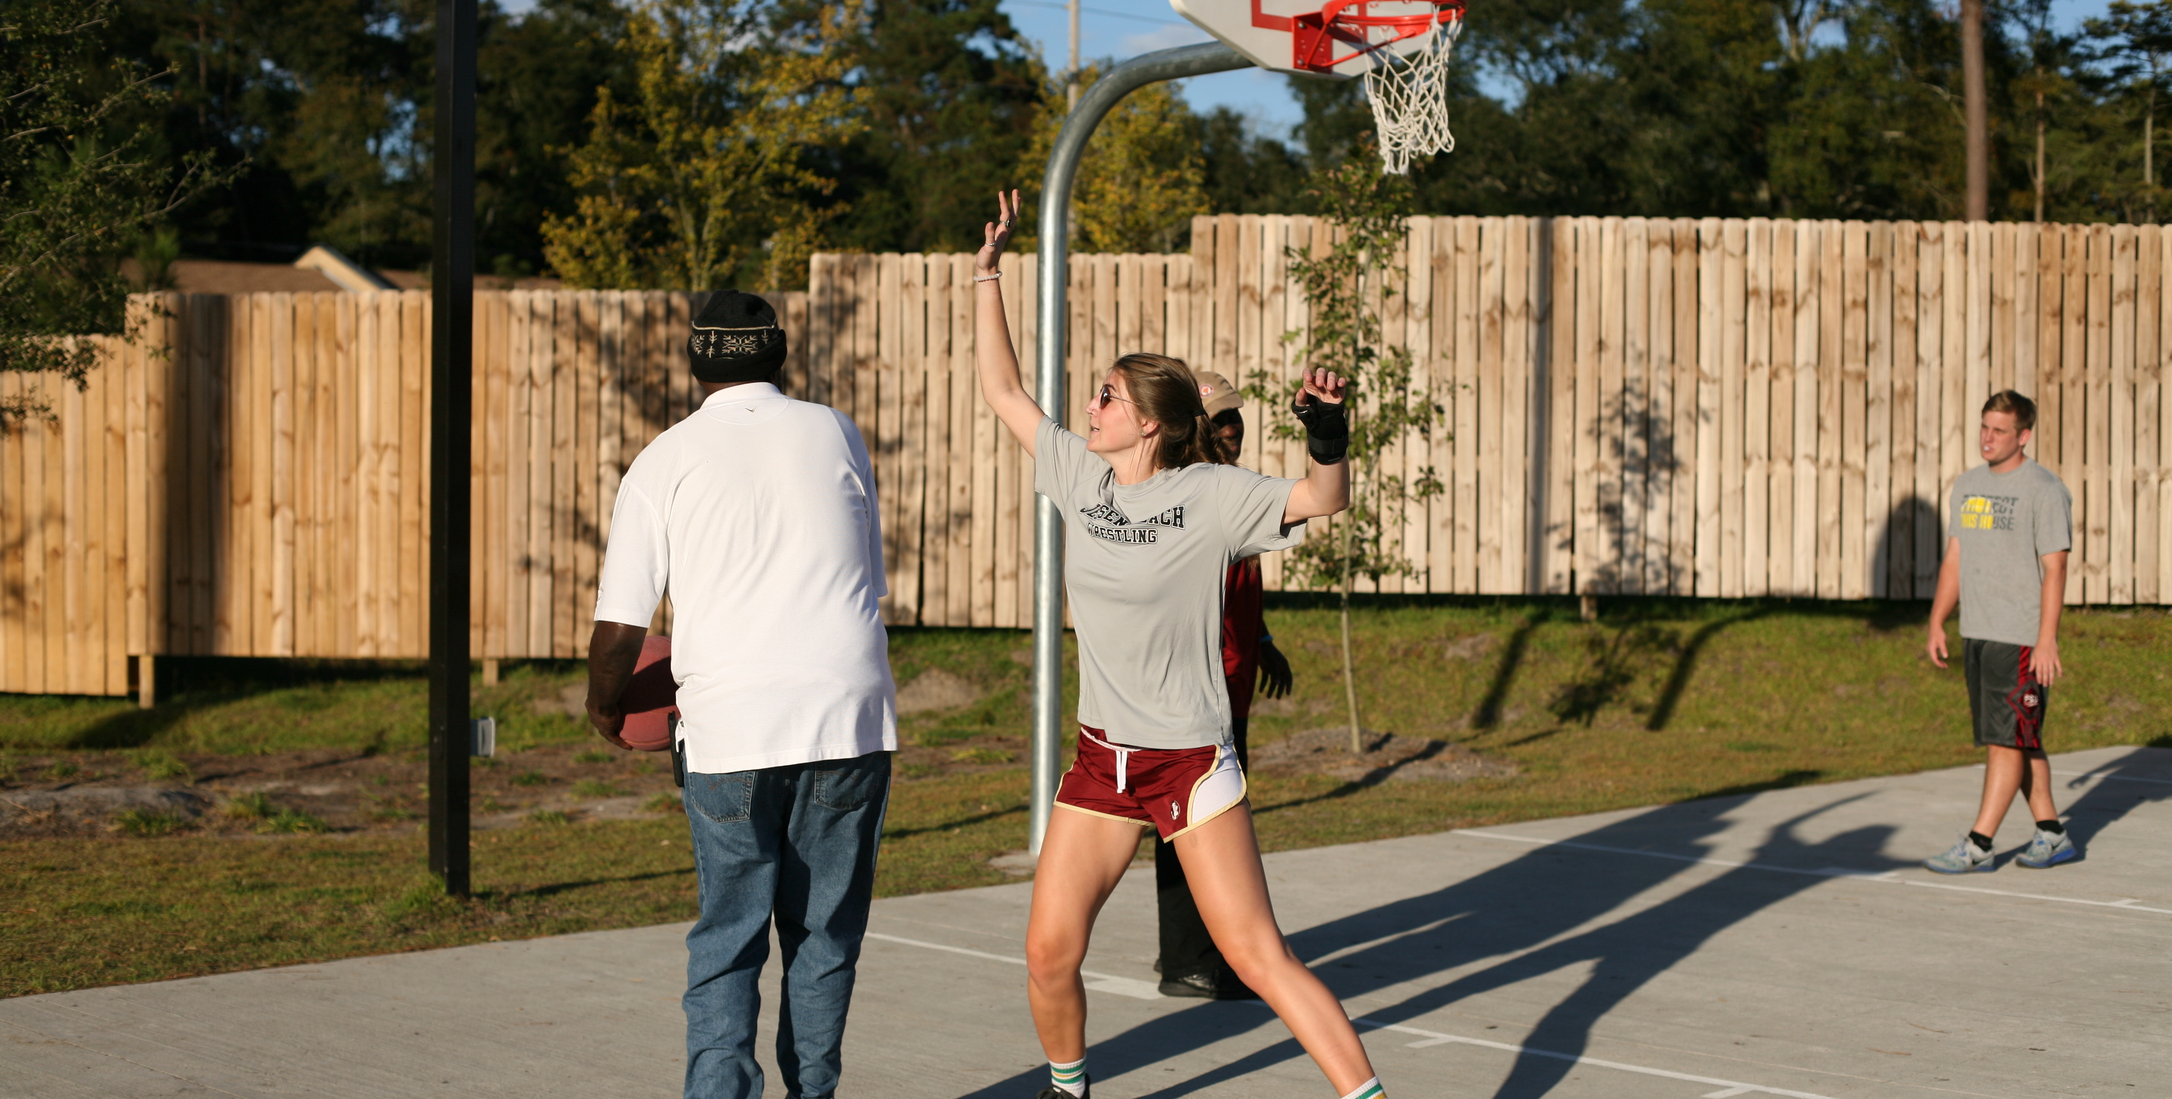
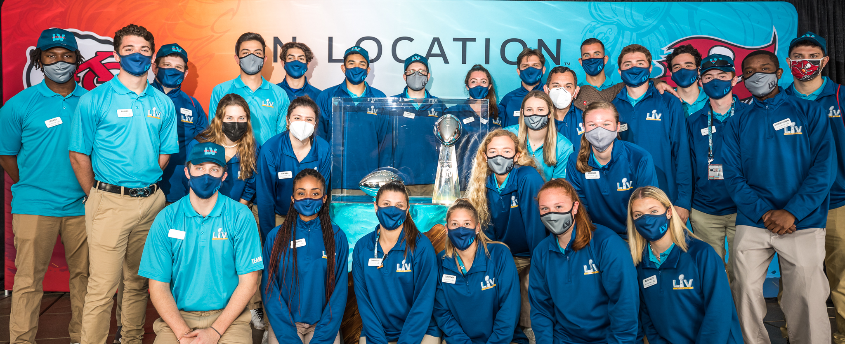
High-Impact Extra-Curricular Activities
A program that impacts our students, the community, and an industry:
Extensive Service Learning and Community Volunteering Programs
International Program in Spain and the United Kingdom
Annual Volunteer Trips
CFP Championship
Men's Final Four
Women’s Final Four
Women's College World Series
Notes:
Service Learning (required hours + individual opportunities)
Volunteer hours – both local (Tallahassee + FSU athletics) and outside community
Study Abroad
(Annual) Volunteer Trips
Super Bowl
WCWS
Women’s Final Four
BCS National Championship Game

Slide 8
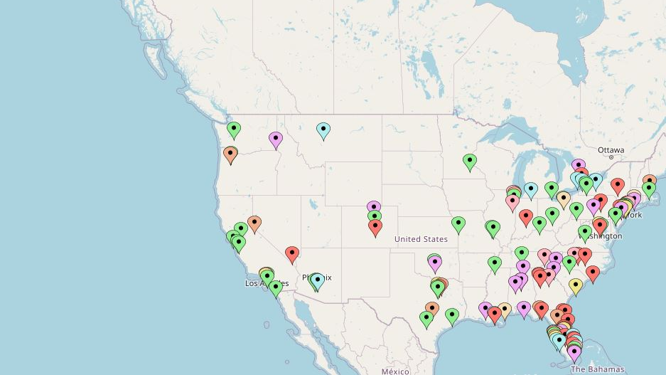
Connect with Our Alumni Network
You will be a part of the FSU Sport Management family…a very big family:
Over 3,800 alumni
Over 1,500 graduate program alumni now working in the sports industry and related fields
Over 100 doctoral program alumni, most of whom are now faculty a major Sport Management programs around the world
Notes:
Pap’s Secret Book

Slide 9
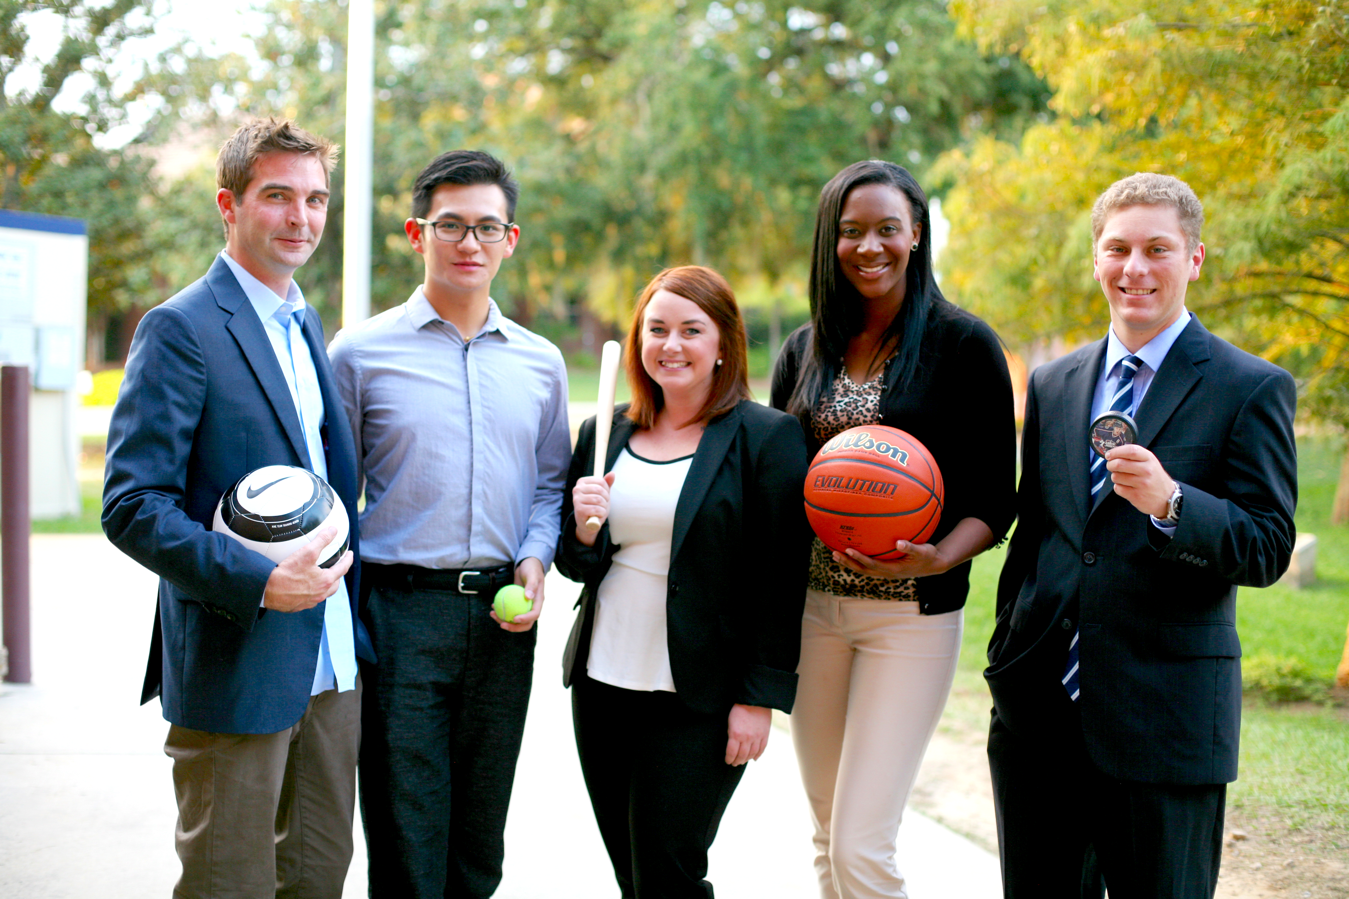
A Diversity of Perspectives and People
Our programs feature of rich diversity of students with varied backgrounds and identities:
Fifty percent of our current PhD students are women
Our graduate programs include students from China, India, Korea, Taiwan, Canada, France, Venezuela, Brazil, Colombia, Germany, Spain, Kuwait, Lebanon, Mexico, Namibia, Nepal, New Zealand, Trinidad & Tobago and South Africa

Slide 10
Undergraduate –
~300 students (2 yr.)
Masters –
~150 students (1-2 yr.)
Doctoral –
~25 students (3-4 yr.)
Notes:
Across the three programs you can see the approximate number of students.
For the undergraduate program, that only accounts for juniors and seniors; we are a discovery program, and students do not begin with us until they have completed 60 hours of coursework.
For our to graduate programs, we do maintain a Canvas site for each degree program.
Canvas is our learning management system in which course resources are housed, and also through which we maintain a common space for communicating, posting news, and storing important information. I’ll have more to say about Canvas later in the presentation.
A bit more about who we are…

Slide 11
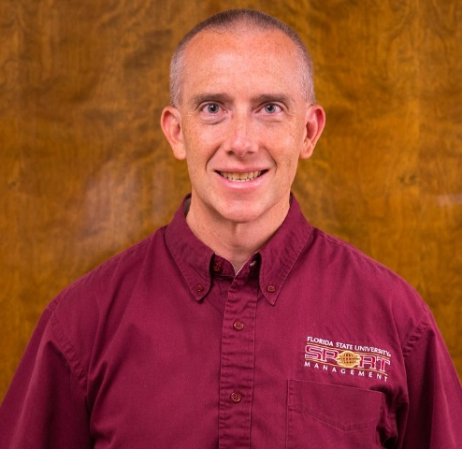
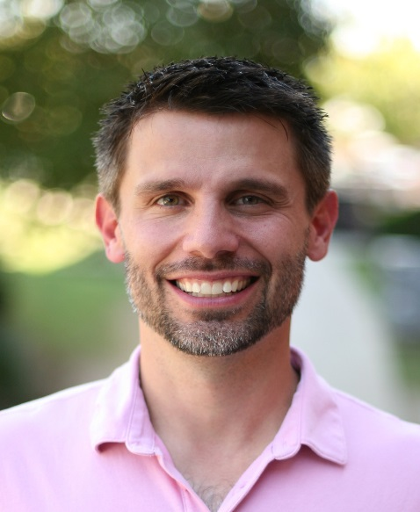
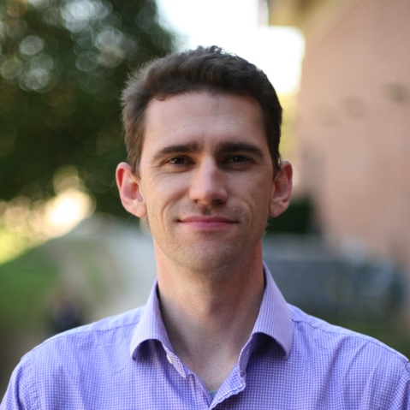
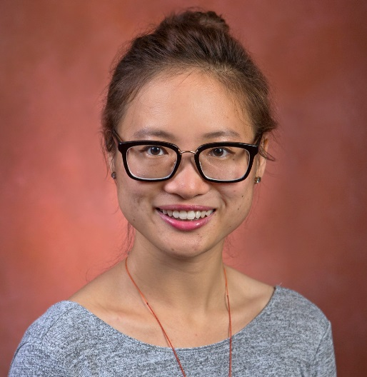
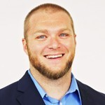
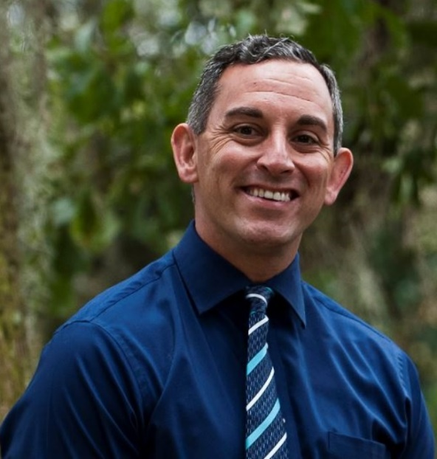
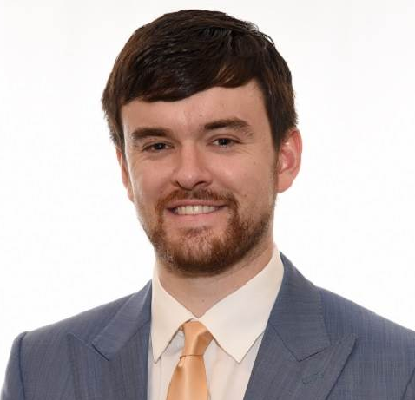
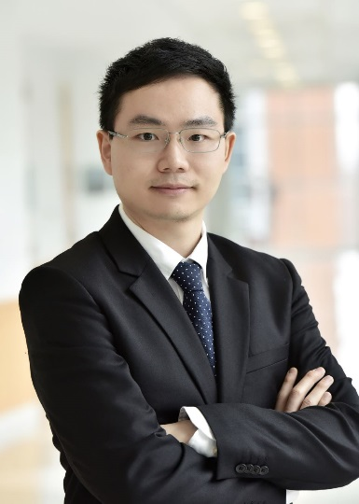
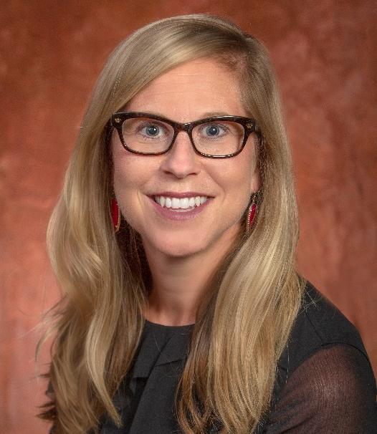
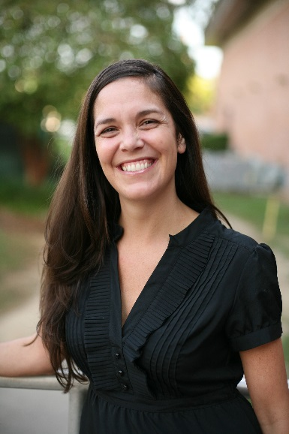
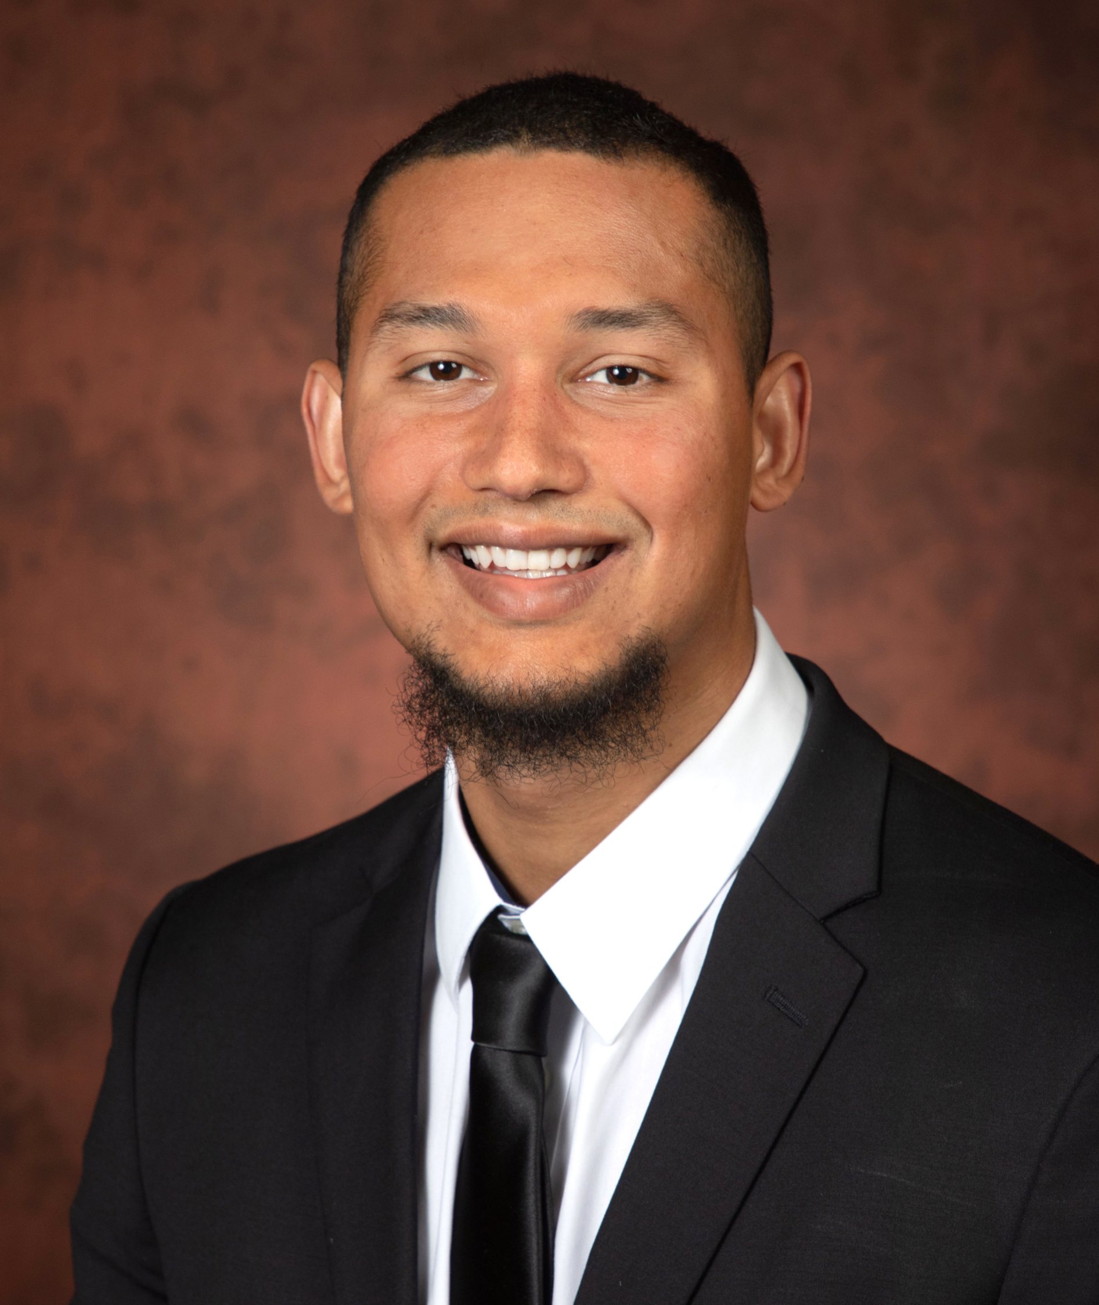
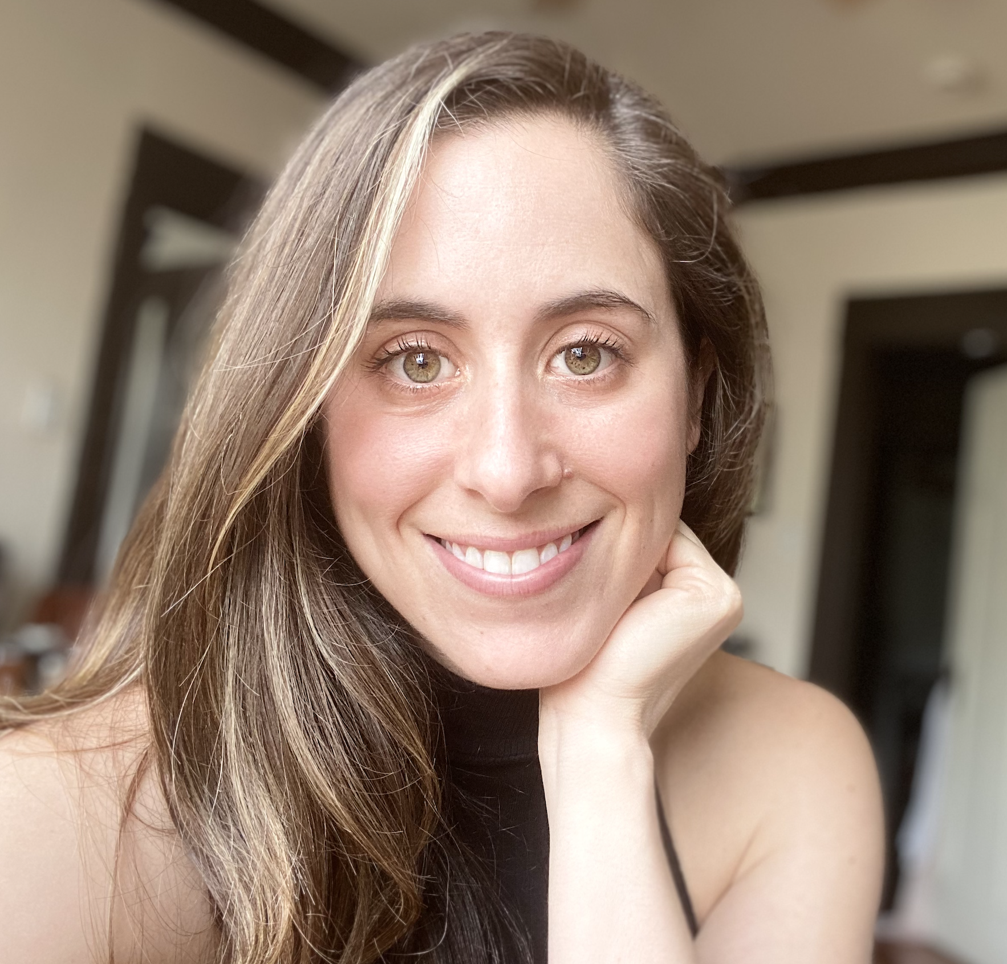
Dr. Jeffrey James - Dr. Joshua Newman - Dr. Michael Giardina - Dr. Ryan Rodenberg - Dr. Amy Kim
Dr. Hanhan Xue - Dr. Mark DiDonato - Dr. Jason Pappas - Dr. David Pifer
Dr. James Du - Dr. Kylee Studer O’Daniel - Dr. Katie Flanagan - Dr. Kristopher White - Dr. Devra Waldman

Slide 12
Master’s Program
Course Work (Practicum) or Thesis Track
Can be completed as quickly as one year (Fall/Spring/Summer) or in a more traditional two-year sequence… or even part-time!
Practicum
Job!
Volunteer
Course work
Network
Field Laboratory
Internship
Thesis
Job!
PhD??
Notes:
Non-Thesis Track
36 hours
18-27 Core
9-18 Elective
The difference is the variable credits for the practicum.
The non-thesis track also includes completion of the Career Portfolio.
[Link to non-thesis track program]
[Handout – Career Portfolio Instructions]
Providing you with a copy of the instructions for Fall 2017, so you can begin thinking about your own portfolio.

Slide 13
COURSE-WORK TRACK
Core Requirements (18-27 hours)
SPM 5116 Strategic Management for Sport Organizations
SPM 5308 Marketing Sport
SPM 5405 Sport and the Media
SPM 5726 Issues in Sport Law
SPM 5907 Professional Development in Sport
SPM 5947* Practicum (variable credit)
SPM 8969 Comprehensive Examination – Career Portfolio (0 hours)
Electives (9-18 hours)
PET 5735 Advanced Coaching SPM 5027 Diversity in Sport
SPM 5106 Facility Management in Sport SPM 5159 Challenges in Sport Management
SPM 5206 Sport Sponsorship and Sales SPM 5605 Sport Governance
SPM 5350 Athlete Recruitment SPM 5708 Applied Sports Analytics
SPM 6517 Fundraising in Sport SPM 6932 Advanced Topics
SPM 5021 Global Sport Venues (International Program – Summer C)
SPM 5022 Global Issues in Sport Management (International Program – Summer C)

Slide 14
THESIS TRACK
Core Requirements (25 hours)
SPM 5116 Strategic Management for Sport Organizations
SPM 5308 Marketing Sport
SPM 5405 Sport and the Media
SPM 5726 Issues in Sport Law
EDF 5400 Basic Descriptive and Inferential Statistics
EDF 5481 Methods of Educational Research (or other research methods course)
SPM 5971 Thesis (6 hours)
SPM 8976 Thesis Defense (0 hours)
Electives (9 hours)
PET 5735 Advanced Coaching SPM 5027 Diversity in Sport
SPM 5106 Facility Management in Sport SPM 5159 Challenges in Sport Management
SPM 5206 Sport Sponsorship and Sales SPM 5605 Sport Governance
SPM 5907 Professional Development in Sport SPM 5708 Applied Sports Analytics
SPM 6517 Fundraising in Sport SPM 6932 Advanced Topics
SPM 5021 Global Sport Venues (International Program – Summer C)
SPM 5022 Global Issues in Sport Management (International Program – Summer C)

Slide 15
JD/MS joint-degree in Law and Sport Management
Students earn a thesis-track MS in Sport Management concurrently with their law degree
Reduced credit hours vs. completing both degrees separately
Apply to the Law School first
Year 1: Law
Year 2: Sport Management (24 credit hours)
Years 3 & 4: Law (with continued work toward SM thesis if necessary)

Slide 16
International Program
GLOBAL SPORT MANAGEMENT
Spain and London during second 6 weeks of summer semester
Two Courses Offered (International Issues & Sport Venues)
Opportunities to see and volunteer at major European sporting events
2002, 2003, 2005, 2006, 2007, 2008, 2009, 2010, 2011, 2012, 2014, 2015, 2016, 2017, 2018, 2019… and 2022!
2023 – Applications being accepted

Slide 17
Application Process
Fall only for MS and PhD programs
Final Deadline: June 1
Rolling admissions decisions – Apply early for assistantship consideration!
Requirements:
Resume
Statement of Purpose
3 Letters of Recommendation
Transcripts (unofficial is OK for application review)
GRE (waived through 2027)

Slide 18
Funding Opportunities
Department Teaching Assistantships
Lifetime Activity Program (LAP)
9- or 12-credit hour tuition waiver
Teaching and/or office duties
Approximately 10 hours per week
Most offers start in Fall term
Apply early! (February/March)
Separate assistantship application
Athletics “GA” Positions
May be paid or volunteer positions
Completely separate from SM department TA positions
May be counted for course credit
Contact Athletics directly to inquire about available positions & process
Seminoles.com/staff-directory

Slide 19
Q & A
with
Dr. Amy Kim

Slide 20
Contact us!
Jeff Hoh
jhoh@fsu.edu
850-644-0577
Or stop by in Tully Gym, room 1004

